Slide 1


React & Redux
Components direct access

Slide 2

Redux is a predictable state container for any JavaScript apps. It gives every components direct access to the data they need.
Redux evolves the ideas of Flux, but avoids its complexity by taking cues from Elm.
Installation
(for React project, use 2 standard packages)
$ npm install redux react-redux --save

Slide 3

Why Should We Use Redux?
In React (one way data flow), data is passed down the component tree via props & through a callback function to come back up the tree.
App
Header
Konten
Tombol
Footer
state:{angka: 26} | klik()
props: angka
props: onClick

Slide 4
Why Should We Use Redux?
App
Header
Navbar
Foto1
Konten
Sidebar
Foto2
Tombol
Footer
state:{user: {...}}
user = {user}
user = {user}
user = {user}
user = {user}

Slide 5
Why Should We Use Redux?
Getting data down like on the previous slide, is quite wasting time. More than that, it’s not a good software design.
Intermediate components in the chain (on this case: Header & Konten) must accept & pass along props that they don’t care about.
It would be nice if the components that didn’t need the data didn’t have to see it at all.
This is the problem that Redux solves. It gives components direct access to the data needed.

Slide 6
Why Should We Use Redux?
App
Header
Navbar
Foto1
Konten
Sidebar
Foto2
Tombol
Footer
Redux Store
user = {user}
state:
{user: {...}}
user = {user}
user = {user}
We can plug any component into Redux’s data store, and the component can pull out the data it requires.
user = {user}

Slide 7
Basic Schema
Install
$ npm install redux react-redux --save
Reducers
Actions
Smart
Component
Pass Data
as
Props
Store
Provider
Dummy Component

Slide 8
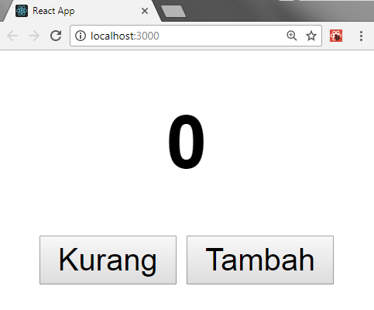
Create without Redux!

Slide 9
src/App.js
#1 Basic Template
import React, { Component } from 'react';
class App extends Component {
state = { count: 0 }
increment = () => {
this.setState({
count: this.state.count + 1
});
}
decrement = () => {
this.setState({
count: this.state.count - 1
});
}

Slide 10
src/App.js
#1 Basic Template
render(){
return (
<div>
<center>
<h1>{this.state.count}</h1>
<div>
<button onClick = {this.decrement}>Kurang
</button>
<span> </span>
<button onClick = {this.increment}>Tambah
</button>
</div>
</center>
</div>
);
}
}
export default App;

Slide 11
src/index.js
#2 Basic template
import React from 'react';
import ReactDOM from 'react-dom';
import App from './App';
ReactDOM.render(<App />, document.getElementById('root'));

Slide 12


?
How to Use
Redux On
React Project
“let’s code step by step”

Slide 13
Remember this schema!
$ npm install redux react-redux --save
Reducers
Actions
Smart
Component
Pass Data
as
Props
Store
Provider
Dummy Component

Slide 14
src/App.js
#1a Import Connect Redux
#1b Delete setState on Func
import React, { Component } from 'react';
import { connect } from 'react-redux';
class App extends Component {
state = { count: 0 }
increment = () => {
// fill in later
}
decrement = () => {
// fill in later
}

Slide 15
render(){
return (
<div>
<center>
<h1>{this.props.count}</h1>
<div>
<button onClick = {this.decrement}>Kurang</button>
<span> </span>
<button onClick = {this.increment}>Tambah</button>
</div>
</center>
</div>
);
}
}
function mapStateToProps(state){
return {
count: state.count
};
}
export default connect(mapStateToProps)(App)
src/App.js
#1c Insert this.props
#1d Connect to Redux

Slide 16
src/index.js
#2 Provide a Store
import React from 'react';
import ReactDOM from 'react-dom';
import App from './App';
import { Provider } from 'react-redux';
ReactDOM.render(<Provider>
<App />
</Provider>,
document.getElementById('root'));

Slide 17
src/index.js
#3 Create a Store
import React from 'react';
import ReactDOM from 'react-dom';
import App from './App';
import { Provider } from 'react-redux';
import { createStore } from 'redux';
const store = createStore();
ReactDOM.render(
<Provider store={store}>
<App />
</Provider>, document.getElementById('root'));

Slide 18
src/index.js
#4 Create a Reducer
import React from 'react';
import ReactDOM from 'react-dom';
import App from './App';
import { Provider } from 'react-redux';
import { createStore } from 'redux';
function reducer(){
return {
count: 42
};
}
const store = createStore(reducer);
ReactDOM.render(
<Provider store={store}>
<App />
</Provider>, document.getElementById('root'));

Slide 19
src/index.js
#5 State and
Action Param
import React from 'react';
import ReactDOM from 'react-dom';
import App from './App';
import { Provider } from 'react-redux';
import { createStore } from 'redux';
const initialState = {
count: 0
};
function reducer(state=initialState, action){
return state;
}
const store = createStore(reducer);
ReactDOM.render(
<Provider store={store}>
<App />
</Provider>, document.getElementById('root'));

Slide 20
src/index.js
#6 Insert Action
. . . . . .
function reducer(state=initialState, action){
switch(action.type){
case 'INCREMENT':
return {
count: state.count + 1
};
case 'DECREMENT':
return {
count: state.count - 1
};
default:
return state;
}
}
. . . . . .

Slide 21
src/App.js
#7 Dispatch Action
. . . . . .
class App extends Component {
state = { count: 0 }
increment = () => {
this.props.dispatch({type:'INCREMENT'});
}
decrement = () => {
this.props.dispatch({type:'DECREMENT'});
}
render(){
. . . . . .

Slide 22
Redux’s in da house!

Slide 23
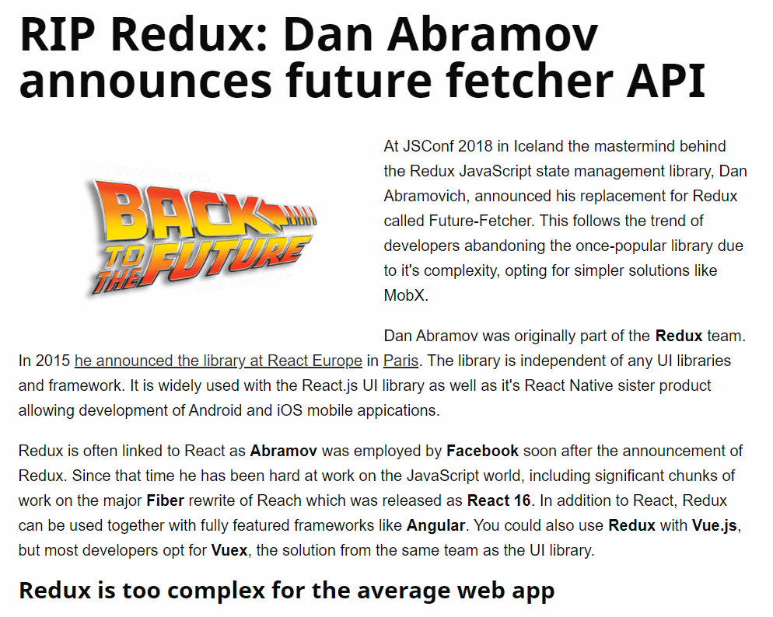
https://react-etc.net/entry/rip-redux-dan-abramov-announces-future-fetcher

Slide 24
React & Redux
Components direct access

